Slide 1
Introduction to Machine Learning and Data Mining (Học máy và Khai phá dữ liệu)
Khoat Than
School of Information and Communication Technology
Hanoi University of Science and Technology

Slide 2
Outline
Introduction to Machine Learning & Data Mining
Unsupervised learning
Supervised learning
Artificial neural network
Practical advice

Slide 3


Artificial neural network: introduction (1)
Artificial neural network (ANN) (mạng nơron nhân tạo)
Simulates the biological neural systems (human brain)
ANN is a structure/network made of interconnection of artificial neurons
Neuron
Has input/output
Executes a local calculation (local function)
Output of a neuron is charactorized by
In/out characteristics
Connections between it and other neurons
(Possible) other inputs

Slide 4
Artificial neural network: introduction (2)
ANN can be thought of as a highly decentralized and parallel information processing structure
ANN has the ability to learn, recall and generalize from the training data
The ability of an ANN depends on
Network architecture
Input/output characteristics
Learning algorithm
Training data

Slide 5
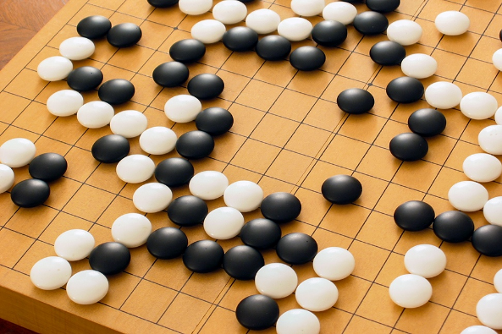

ANN: a huge breakthrough
AlphaGo of Google the world champion at Go, 3/2016
Go is a 2500 year-old game.
Go is one of the most complex games
AlphaGo learns from 30 millions human moves, and plays itself to find new moves
It beat Lee Sedol (World champion)
http://www.wired.com/2016/03/two-moves-alphago-lee-sedol-redefined-future/
http://www.nature.com/news/google-ai-algorithm-masters-ancient-game-of-go-1.19234

Slide 6
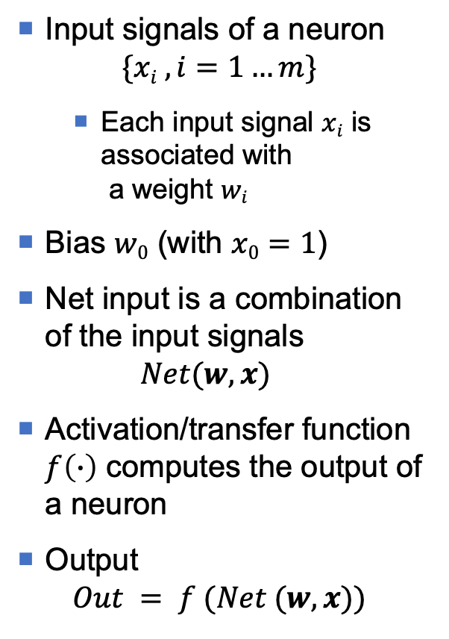
Structure of a neuron
Input signals of a neuron $\{xi ,i=1…m\}$
Each input signal $xi$ is associated with a weight $wi$
Bias $w0$ (with $x0=1$)
Net input is a combination of the input signals $Net(w, x)$
Activation/transfer function $f\left(∙\right)$ computes the output of a neuron
Output $Out = f (Net (w,x))$
x₀=1
x₁
w₀
w₁
x₂
Output(Out)
w₂
Σ
…
w_{m}
x_{m}
Input (x)
Net input
(Net)
Activation/ transfer function
(f)

Slide 7
Net Input
Net input is usually calculated by a function of linear form
Role of bias:
Net=w₁x₁ may not separate well the classes
Net=w₁x₁+w₀ is able to do better
Net
Net
Net = w₁x₁
Net = w₁x₁ + w₀
x₁
x₁

Slide 8
Activation function: hard-limited
Also known as a threshold function
The output takes one of the two values
θ is the threshold value
Properties: discontinuous, non-smoothed (không liên tục, không trơn)
Out
Out
Bipolar hard-limiter
Binary hard-limiter
1
1
θ
0
Net
θ
0
Net
-1

Slide 9

Activation function: threshold logic
Also known as a saturating linear function
Combination of 2 activation functions: linear and tight limits
$α$determines the slope of the linear range
Properties: continuous, non-smoothed (liên tục, không trơn)
(α >0)
Out
1
-θ
0
(1/α)-θ
Net
1/α

Slide 10
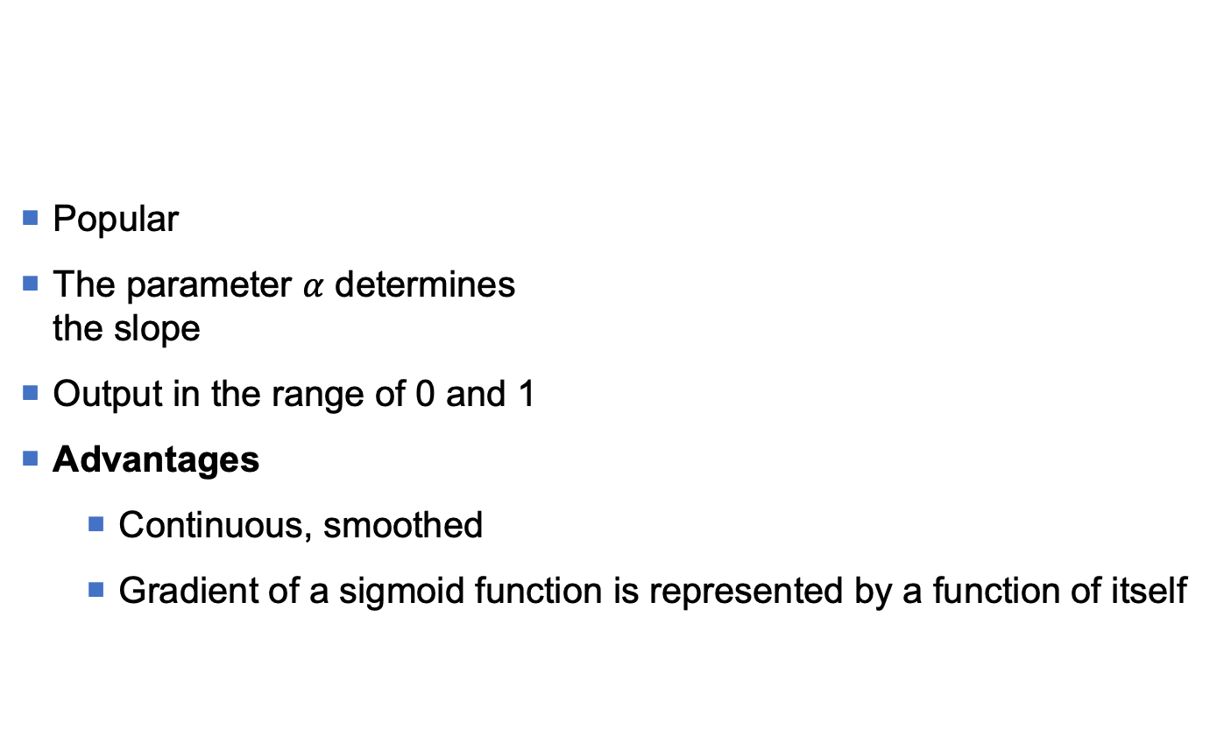
Activation function: Sigmoid
Popular
The parameter $α$ determines the slope
Output in the range of 0 and 1
Advantages
Continuous, smoothed
Gradient of a sigmoid function is represented by a function of itself
Out
1
0.5
-θ
0
Net

Slide 11
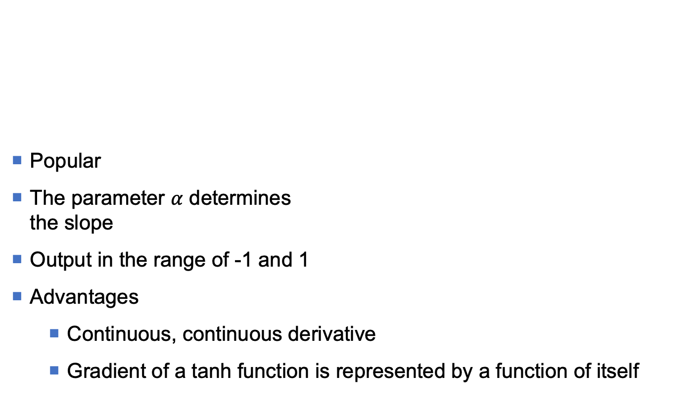
Activation function: Hyperbolic tangent
Popular
The parameter $α$ determines the slope
Output in the range of -1 and 1
Advantages
Continuous, continuous derivative
Gradient of a tanh function is represented by a function of itself
Out
1
-θ
0
Net
-1

Slide 12
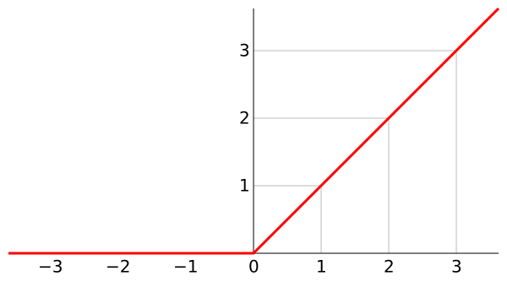

Act. function: Rectified linear unit (ReLU)
$$Out\left(net\right)=max⁡(0, net)$$
Most popular
Output is non-negative
Advantages
Continuous
No derivative at point 0
Easy to calculate

Slide 13
ANN: Architecture (1)
ANN’s architecture is determined by
Number of input and output signals
Number of layers
Number of neurons in each layer
Number of connection for each neuron
How neurons (with in a layer, or between layers) are connected
An ANN must have
An input layer
An output layer
No, single, or multiple hidden layers
bias
input
hidden layer
output layer
output
E.g: An ANN with single hidden layer
Input: 3 signals
Output: 2 signals
Total, have 6 neurons
4 neurons at hidden layer
2 neurons at output layer

Slide 14
ANN: Architecture (2)
A layer (tầng) contains a set of neurons
Hidden layer (tầng ẩn) is a layer between input layer and output layer
Hidden nodes do not interact directly with external environment of the neural network
An ANN is called a fully connected if outputs of a layer are connected to all neurons of the next layer

Slide 15
ANN: Architecture (3)
An ANN is called a feed-forward network (mạng lan truyền tiến) if there is not any output of a node being input of another node of the same layer or a previous layer
When the output of a node is the input of the node the same layer or a previous layer, it is called a feedback network (mạng phản hồi)
If feedback connects to the input of nodes of the same layer, then it is called a lateral feedback.
Feedback networks with closed loops are called recurrent networks (mạng hồi quy)

Slide 16
ANN: Architecture (4)
A neuron with feedback to itself
Feed-forward network
Recurrent network with single layer
Feed-forward network with multiple layers
Recurrent network with multiple layers

Slide 17
ANN: Training
2 types of learning in ANNs
Parameter learning: The goal is to adapt the weights of the connections in the ANN, given a fixed network structure
Structure learning: The goal is to learn the network structure, including the number of neurons and the types of connections between them, and the weights
Those two types can be done simultaneously or separately
In this lecture, we will only consider parameter learning
Or

Slide 18
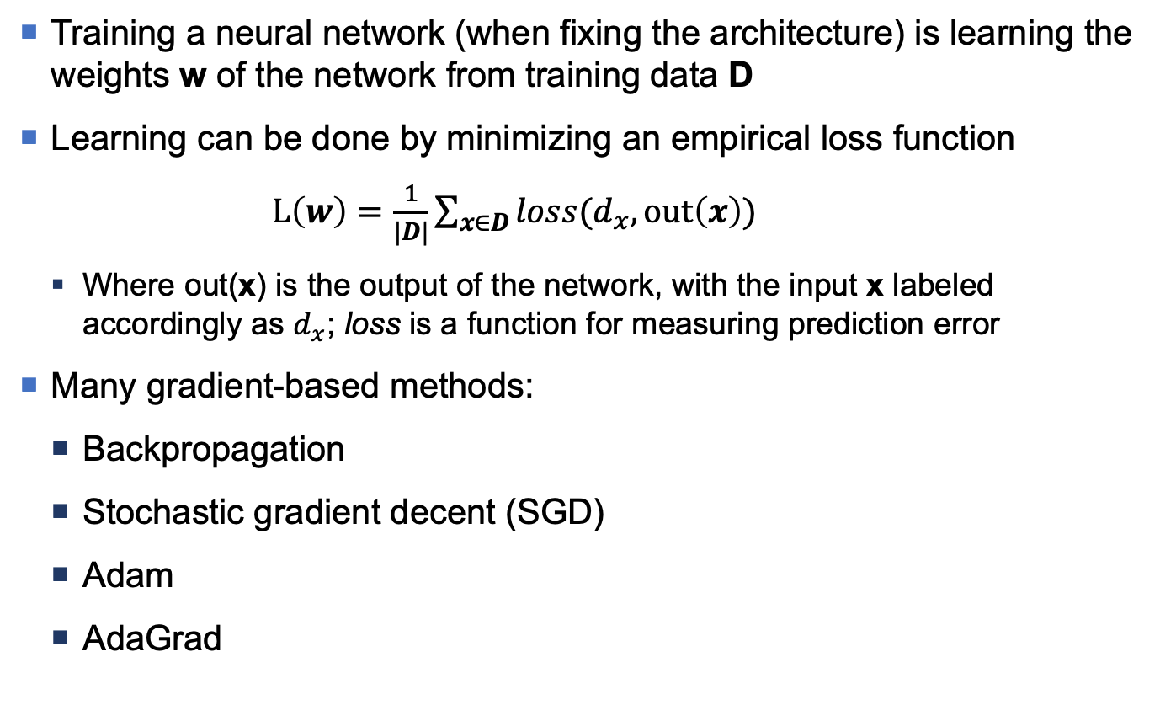
ANN: Idea for training
Training a neural network (when fixing the architecture) is learning the weights w of the network from training data D
Learning can be done by minimizing an empirical loss function
$L\left(w\right)=\frac{1}{|D|}\sum_{x∈D}{loss(d_{x}, out\left(x\right))}$
Where out(x) is the output of the network, with the input x labeled accordingly as $d_{x}$; loss is a function for measuring prediction error
Many gradient-based methods:
Backpropagation
Stochastic gradient decent (SGD)
Adam
AdaGrad
x₀
x₁
w₀
x₂
w₁
w₂
Σ
Out
…
x_{m}
w_{m}

Slide 19
Perceptron
A perceptron is the simplest type of ANNs (only one neuron).
Use the hard-limited activation function
For input x, the output value of perceptron
1 if Net(w,x)>0
-1 otherwise
x₀=1
x₁
w₀
w₁
x₂
Out
w₂
Σ
…
w_{m}
x_{m}
separation plane w₀+w₁x₁+w₂x₂=0
x₁
Output = 1
Output = -1
x₂

Slide 20
Perceptron: Algorithm
Training data D = {(x, d)}
x is input vector
d is output (1 or -1)
The goal of perceptron learning (training) process determines a weight vector that allows the perceptron to produce the correct output value (-1 or 1) for each data point
For data point x correctly classified by perceptron, the weight vector w unchanged
If d = 1 but the perceptron produces -1 (Out = -1), then w needs to be changed so that the value of Net (w, x) increases
If d = -1 but the perceptron produces 1 (Out = 1), then w needs to be changed so that the value of Net (w, x) decreases

Slide 21
Perceptron: Batch training
Perceptron_batch(D, η)
Initialize w (w_{i} ← an initial (small) random value)
do
∆w ← 0
for each training instance (x,d)∈D
Compute the real output value Out
if (Out≠d)
∆w ← ∆w + η(d-Out)x
end for
w ← w + ∆w
until all the training instances in D are correctly classified
return w

Slide 22
Perceptron: Limitation
The training algorithm for perceptron is proved to converge if:
Data points are linearly separable
Use a learning rate η small enough
The training algorithm for perceptron may not converge if data points are not linearly separable
A perceptron cannot classify correctly for this case!

Slide 23
Loss function
Consider an ANN that has n output neurons
For data point (x, d), the training error value caused by the (current) weight vector w:
Training error for the training data D is

Slide 24
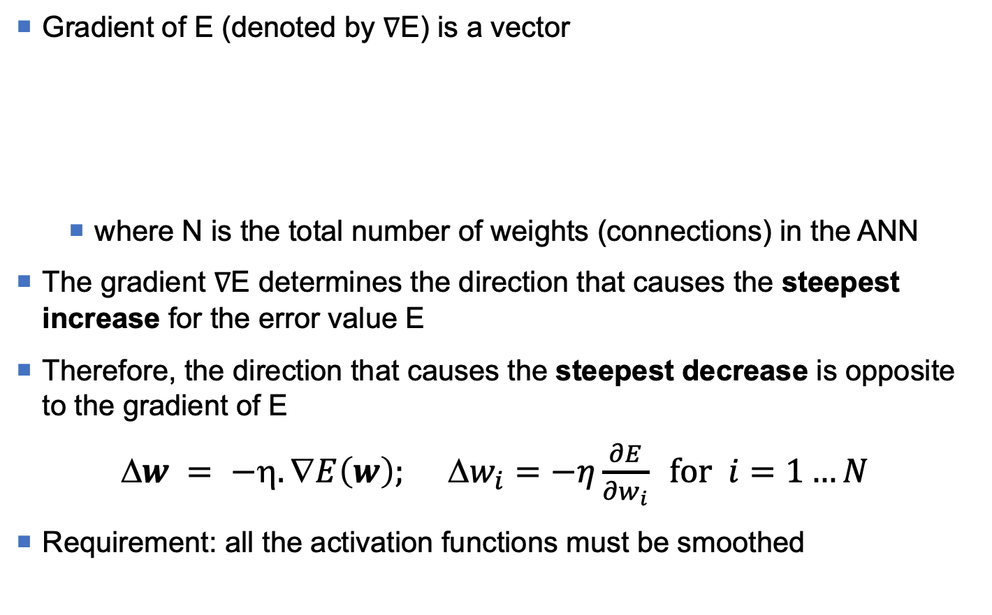
Minimize errors with gradients
Gradient of E (denoted by $∇$E) is a vector
where N is the total number of weights (connections) in the ANN
The gradient ∇E determines the direction that causes the steepest increase for the error value E
Therefore, the direction that causes the steepest decrease is opposite to the gradient of E
$w = −η.∇E\left(w\right); Δw_{i}=−η\frac{∂E}{∂w_{i}} \text{for} i=1…N$
Requirement: all the activation functions must be smoothed

Slide 25
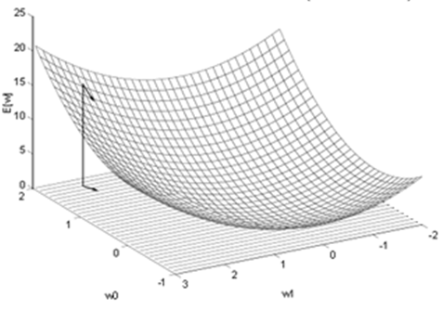
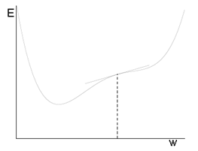
Gradient descent: Illustration
2-dimensional space E(w₁,w₂)
One-dimensional space E(w)

Slide 26
Incremental training
Gradient_descent_incremental (D, η)
Initialize w (w_{i} ← an initial (small) random value)
do
for each training instance (x,d)∈D
Compute the network output
for each weight component w_{i}
w_{i} ← w_{i} – η(∂E_{x}/∂w_{i})
end for
end for
until (stopping criterion satisfied)
return w
If we take a small subset (mini-batch) randomly from D to update the weights, we will have mini-batch training.
Stopping criterion: epochs, threshold error, ...

Slide 27
Backpropagation algorithm
A perceptron can only represent a linear function
A multi-layer NN learned by the Backpropagation (BP) algorithm can represent a highly non-linear function
The BP algorithm is used to learn the weights of an ANN
Fixed network structure (một cấu trúc mạng đã chọn trước)
For each neuron, the activation function must be differentiable
The BP algorithm applies a gradient descent strategy to the rules for updating weights
To minimize errors between actual output values ​​and desired output values, for training data

Slide 28
Backpropagation algorithm (1)
Back propagation algorithm seeks a vector of weights that minimizes the net errors on the training data
The BP algorithm consists of 2 phases:
Forward pass: The input signals (input vector) are forwarded from the input layer to the output layer (passing through hidden layers).
Error backward:
Based on the desired output value of the input vector, calculate the error value
From the output layer, the error value is backward-propagated across the network, from a layer to previous layer, to the input layer.
Error back-propagation is executed by calculating (regressively) the local gradient values ​​of each neuron

Slide 29
Backpropagation algorithm (2)
Signal forward phase:
Forward signals via the network
Error backward phase:
Calculate the error at the output
Error back-propagation

Slide 30
Network structure
Input x_{j} (j=1..m)
x₁
x_{j}
x_{m}
Consider the 3-layer neural network (in the figure) to illustrate the BP algorithm
m input signals x_{j} (j=1..m)
l hidden neurons z_{q} (q=1..l)
n output neurons y_{i} (i=1..n)
w_{qj} is the weight of the connection from the input signal x_{j} to the hidden neuron z_{q}
w_{iq} is the weight of the connection from the hidden neuron z_{q} to the output y_{i}
Out_{q} is the (local) output value of the hidden neuron z_{q}
Out_{i} is the output value of the network corresponding to the output neuron y_{i}
...
...
w_{qj}
Hidden neuron z_{q} (q=1..l)
...
Out_{q}
...
w_{iq}
Output neuron y_{i} (i=1..n)
...
...
Out_{i}

Slide 31
BP algorithm: Forward (1)
For each data point x
Input vector x is forwarded from the input layer to the output layer
The network will generate an actual output value Out (a vector with value Out_{i}, i = 1..n)
For an input vector x, a neuron z_{q} at the hidden layer receives the value of net input:
then produces a (local) output value
where f(.) is a activation function of neuron z_{q}

Slide 32
BP algorithm: Forward (2)
Net input value of the neuron y_{i} at the output layer
Neuron y_{i} produces output value (is an output value of network)
Vector of the output values Out_{i} (i=1..n) is the actual output value of the network, for the input vector x

Slide 33
BP algorithm: Backward (1)
For each data point x
Error signals due to the difference between the desired output value d and the actual output value Out are calculated
These error signals are back-propagated from the output layer to the front layers, to update weights
To consider the error signals and their back-propagated ones, an error function needs to be defined

Slide 34
BP algorithm: Backward (2)
According to the gradient-descent method, the weights of the connections from the hidden layer to the output layer are updated by
Using the derivative chain rule for ∂E/∂w_{iq}, we have
δ_{i} is error signals of neuron y_{i} at output layer
where Net_{i} is the net input of the neuron y_{i} at the output layer, and f'(Net_{i})=∂f(Net_{i})/∂Net_{i}

Slide 35
BP algorithm: Backward (3)
To update the weights of the connections from the input layer to the hidden layer, we also apply the gradient-descent method and the derivative chain rule
From the formula for calculating the error function E(w), we see that each error component (d_{i}-y_{i}) (i=1..n) is a function of Out_{q}

Slide 36
BP algorithm: Backward (4)
Apply the derivation chain rule, we have
δ_{q} is error signals of neuron z_{q} at hidden layer
where Net_{g} is the net input of the neuron z_{q} at the hidden layer, and f'(Net_{q})=∂f(Net_{q})/∂Net_{q}

Slide 37
BP algorithm: Backward (5)
According to the formulas for calculating the error signals δ_{i} and δ_{q}, the error signal of a neuron in the hidden layer is different from the error signal of a neuron in the output layer
Because of this difference, the weight update procedure in BP algorithm is also known as general delta learning rule
Error signals δ_{q} of neuron z_{q} at hidden layer determined by:
Error signals δ_{i} of neuron y_{i} at output layer (to which neuron z_{q} are connected)
The weights w_{iq}

Slide 38
BP algorithm: Backward (6)
The process of calculating the error signals as above can be extended (generalized) easily for neural networks with more than 1 hidden layer
The general form of the weighting update rule in BP algorithm
Δw_{ab} = ηδ_{a}x_{b}
b and a are 2 indices corresponding to the two ends of the connection (b → a) (from a neuron (or input signal) b to neuron a)
x_{b} is the output value of the neuron at the hidden layer (or input signal) b
δ_{a} is error signal of neuron a

Slide 39
BP algorithm
Back_propagation_incremental(D, η)
Neural network consists of Q layer, q = 1,2,...,Q
^{q}Net_{i} and ^{q}Out_{i} are net input and output value of neuron i at the layer q
Network has m input signals and n output neuron
^{q}w_{ij} is the weight of the connection from neuron j at the layer (q-1) to the neuron i at the layer q
Step 0 (Initialization)
Select the error threshold E_{threshold} (the error value is acceptable)
Initialize the initial value of the weights with random small values
Assign E=0
Step 1 (Start a training cycle)
Apply the input vector of the data point k to the input layer (q=1)
^{q}Out_{i} = ¹Out_{i} = x_{i}^{(k)}, ∀i
Step 2 (Forward)
Forward the input signals over the network, until the network output values ​​(at the output layer) are received ^{Q}Out_{i}

Slide 40
BP algorithm
Step 3 (Calculate the output error)
Calculate network output error and error signal ^{Q}δ_{i} of each neuron at output layer
Step 4 (Error backward)
Backpropagation the error to update the weights and calculate the error signals ^{q-1}δ_{i} for the front layers
Δ^{q}w_{ij} = η.(^{q}δ_{i}).(^{q-1}Out_{j}); ^{q}w_{ij} = ^{q}w_{ij} + Δ^{q}w_{ij}
Step 5 (Check stopping criterion satisfied)
Check if the entire training data has been used yet
If the entire training data has used, go to Step 6, otherwise go to Step 1
Step 6 (Check net error)
If net error E is less than the acceptable threshold (<E_{threshold}), then training is completed and returns the learned weights;
otherwise, assign E=0, and start new training cycle (go back to Step 1)

Slide 41
BP algorithm: Forward (1)
f(Net₁)
f(Net₄)
Out₆
f(Net₆)
f(Net₂)
f(Net₅)
f(Net₃)

Slide 42
BP algorithm: Forward (2)
f(Net₁)
f(Net₄)
Out₆
f(Net₆)
f(Net₂)
f(Net₅)
f(Net₃)

Slide 43
BP algorithm: Forward (3)
f(Net₁)
f(Net₄)
Out₆
f(Net₆)
f(Net₂)
f(Net₅)
f(Net₃)

Slide 44
BP algorithm: Forward (4)
f(Net₁)
f(Net₄)
Out₆
f(Net₆)
f(Net₂)
f(Net₅)
f(Net₃)

Slide 45
BP algorithm: Forward (5)
f(Net₁)
f(Net₄)
Out₆
f(Net₆)
f(Net₂)
f(Net₅)
f(Net₃)

Slide 46
BP algorithm: Forward (6)
f(Net₁)
f(Net₄)
Out₆
f(Net₆)
f(Net₂)
f(Net₅)
f(Net₃)

Slide 47
BP algorithm: Forward (7)
f(Net₁)
f(Net₄)
f(Net₆)
f(Net₂)
f(Net₅)
f(Net₃)

Slide 48
BP algorithm: Calculate error
f(Net₁)
f(Net₄)
δ₆
Out₆
f(Net₆)
f(Net₂)
f(Net₅)
d is the desired output value
f(Net₃)

Slide 49
BP algorithm: Backward(1)
f(Net₁)
δ₄
f(Net₄)
δ₆
Out₆
f(Net₆)
f(Net₂)
f(Net₅)
f(Net₃)

Slide 50
BP algorithm: Backward(2)
f(Net₁)
f(Net₄)
δ₆
Out₆
f(Net₆)
f(Net₂)
δ₅
f(Net₅)
f(Net₃)

Slide 51
BP algorithm: Backward(3)
δ₁
f(Net₁)
δ₄
f(Net₄)
Out₆
f(Net₆)
f(Net₂)
δ₅
f(Net₅)
f(Net₃)

Slide 52
BP algorithm: Backward(4)
f(Net₁)
δ₄
f(Net₄)
δ₂
Out₆
f(Net₆)
f(Net₂)
δ₅
f(Net₅)
f(Net₃)

Slide 53
BP algorithm: Backward(5)
f(Net₁)
δ₄
f(Net₄)
Out₆
f(Net₆)
f(Net₂)
δ₅
f(Net₅)
δ₃
f(Net₃)

Slide 54
BP algorithm: Update weight(1)
δ₁
f(Net₁)
f(Net₄)
Out₆
f(Net₆)
f(Net₂)
f(Net₅)
f(Net₃)

Slide 55
BP algorithm: Update weight(2)
f(Net₁)
f(Net₄)
δ₂
Out₆
f(Net₆)
f(Net₂)
f(Net₅)
f(Net₃)

Slide 56
BP algorithm: Update weight(3)
f(Net₁)
f(Net₄)
Out₆
f(Net₆)
f(Net₂)
f(Net₅)
δ₃
f(Net₃)

Slide 57
BP algorithm: Update weight(4)
f(Net₁)
δ₄
f(Net₄)
Out₆
f(Net₆)
f(Net₂)
f(Net₅)
f(Net₃)

Slide 58
BP algorithm: Update weight(5)
f(Net₁)
f(Net₄)
Out₆
f(Net₆)
f(Net₂)
δ₅
f(Net₅)
f(Net₃)

Slide 59
BP algorithm: Update weight(6)
f(Net₁)
f(Net₄)
δ₆
Out₆
f(Net₆)
f(Net₂)
f(Net₅)
f(Net₃)

Slide 60
BP algorithm: Initialize weights
Normally, weights are initialized with random small values
If the weights have large initial values
Sigmoid functions will reach saturation soon
The system will deadlock at a saddle / stationary points

Slide 61
BP algorithm: Learning rate
Important effect on the efficiency and convergence of BP algorithm
A large value of η can accelerate the convergence of the learning process, but can cause the system to ignore the global optimal point or focus on bad points (saddle points).
A small η value can make the learning process take a long time
Often select it empirically
Good values ​​of learning rate at the beginning (learning process) may not be good at a later time
Using an adaptive (dynamic) learning rate?

Slide 62

BP algorithm: Momentum
The gradient descent method can be very slow if η is small and can fluctuate greatly if η is too large
To reduce the level of fluctuations, it is necessary to add a momentum component
Δw^{(t)} = -η∇E^{(t)} + αΔw^{(t-1)}
where α (∈[0,1]) is a momentum parameter (usually assign = 0.9)
We should choose reasonable values for learning rate and satisfying momentum
$(+) ≳ 1$
where $>$ to avoid fluctuations
αΔw(t’)
-η∇E(t’+1)
-η∇E(t’+1) + αΔw(t’)
Δw(t’)
B
A’
A
Δw(t)
B’
-η∇E(t+1)
αΔw(t)
-η∇E(t+1) + αΔw(t)
Gradient descent for a simple square error function.
The left trajectory does not use momentum.
The right trajectory uses momentum.

Slide 63
BP algorithm: Number of neurons
The size (number of neurons) of the hidden layer is an important question for the application of multi-layer neural network to solve practical problems
In fact, it is difficult to identify the exact number of neurons needed to achieve the desired system accuracy
The size of the hidden layer is usually determined through experiments (experiment/trial and test)

Slide 64
ANN: Learning limit
Boolean functions
Any binary function can be learnt (approximately well) by an ANN using one hidden layer
Continuous functions
Any bounded continuous function can be learnt (approximately) by an ANN using one hidden layer [Cybenko, 1989; Hornik et al., 1991]

Slide 65
ANN: advantages, disadvantages
Advantages
Supports high-level parallel computation
Obtain high accuracy in many problems (image, video, audio, text)
Be flexible in network architecture
Disadvantages
There is no general rule for determining the network architecture and optimal parameters for a given problem
It is unclear about ANN's inner workings (thus, the ANN system is viewed as a "black box").
It is difficult (impossible) to give explanations to the user
Fundamental theories are few, to help explain the real successes

Slide 66
ANN: When?
The form of the learned function does not predetermined
It is not necessary (or unimportant) to provide an explanation to the user about the results
Accept long time for the training process
Can collect a large number of labels for data
Application domains relate to image, video, speech, text

Slide 67




Open library

Slide 68
References
Cybenko, G. (1989) "Approximations by superpositions of sigmoidal functions", Mathematics of Control, Signals, and Systems, 2 (4), 303-314
Kurt Hornik (1991) "Approximation Capabilities of Multilayer Feedforward Networks", Neural Networks, 4(2), 251–257

